Slide 1




MOD-SEM SuSe25
Topic 3 - Phase 1
Hyperuniformity
Generation of hyperuniform structures and their analysis
Title of the presentation
Organizational unit of TU Dresden / Last Name, First Name of the speaker
Location or occasion of the presentation // May 4, 2022
Slide ‹Nr.›

Slide 2
Contents -Phase 1
Introduction to hyperuniformity
Generation of hyperuniform structures and their analysis
Generation of HU point patterns
...
...
...
Literature
Hyperuniformity
Generation of hyperuniform structures and their analysis
MOD-SEM SuSe25 // May 12, 2025
Page 2 of 17

Slide 3
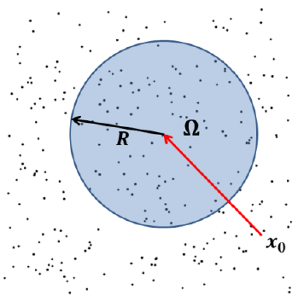
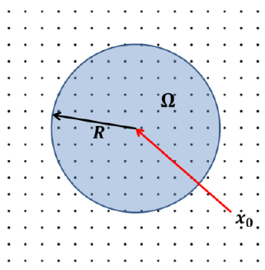
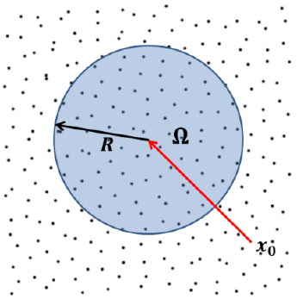
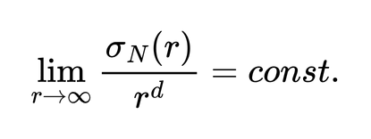
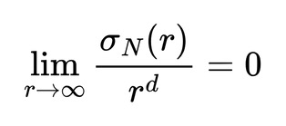
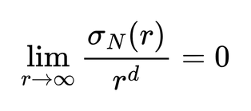
Introduction
Hyperuniform systems are defined by the suppression of density fluctuations over large spatial scales.
The number variance inside an observation window grows more slowly than its radius:
Hyperuniformity
Generation of hyperuniform structures and their analysis
MOD-SEM SuSe25 // May 12, 2025
Page 3 of 17
*[Tor18]

Slide 4
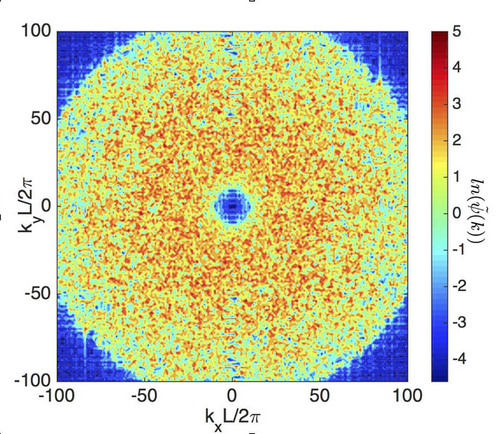
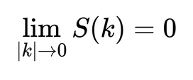
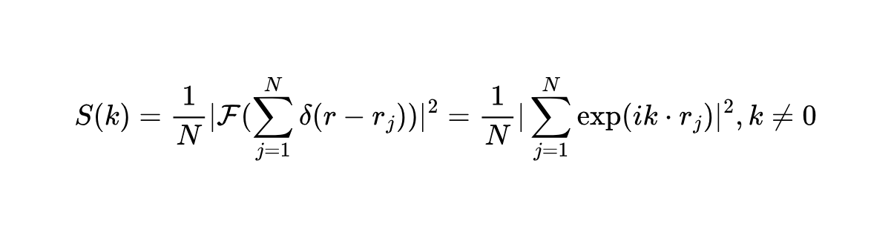
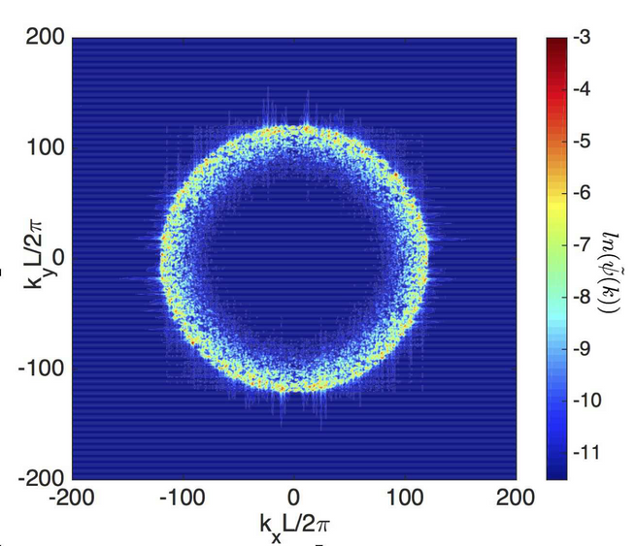
Introduction
The Structure Factor
Equivalently, one can derive from internal correlation and fourier transform [Tor18] that hyperuniformity may be characterized by a vanishing structure factor for small wave vectors
For a single periodic configuration with a finite number of N points, the structure factor is identical to [Tor18]:
Hyperuniformity
Generation of hyperuniform structures and their analysis
MOD-SEM SuSe25 // May 12, 2025
Page 4 of 17
*[MT17]

Slide 5
Generating hyperuniform structures
(Responsible: Enno)
Hyperuniformity
Generation of hyperuniform structures and their analysis
MOD-SEM SuSe25 // May 12, 2025
Page 5 of 17

Slide 6
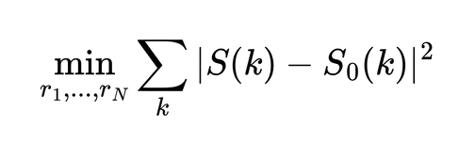
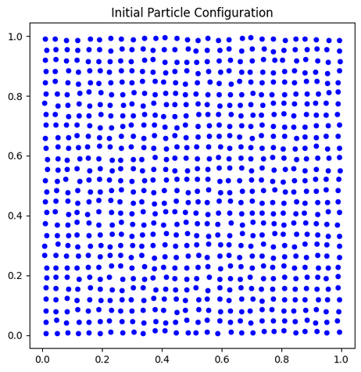
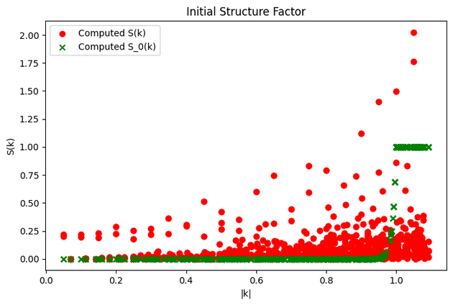
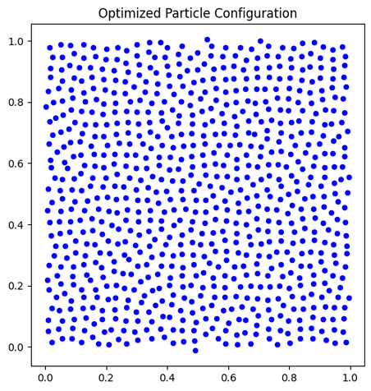
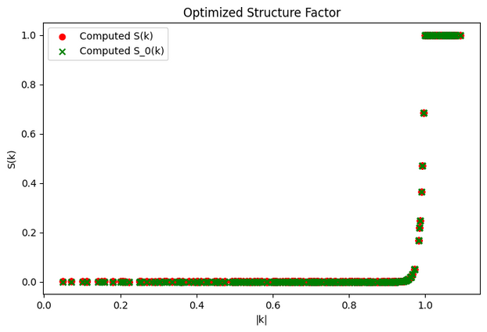
Generating hyperuniform structures
HU point patterns
We may use a method based on optimization [SSDV24] towards a given structure factor
Task: generate different kinds of hyperuniform point patterns as in [SSDV24], Section II
Current progress:
Some more testing needed for different S_0 parametrizations
Hyperuniformity
Generation of hyperuniform structures and their analysis
MOD-SEM SuSe25 // May 12, 2025
Page 6 of 17

Slide 7
Generating hyperuniform structures
Scalable HU point patterns
We want to generate large point patterns for later analysis
In [SCM24] an scalable fft-based approach to generating HU point patterns is proposed
Task: generate larger point patterns using nuFFT and compare runtime to previous method
Hyperuniformity
Generation of hyperuniform structures and their analysis
MOD-SEM SuSe25 // May 12, 2025
Page 7 of 17

Slide 8
Generating hyperuniform structures
HU scalar fields
Hyperuniformity can be extended to scalar fields
We may be able to extend analysis of HU point patterns to analysis of HU scalar fields
Task: Generate hyperuniform scalar field from a gaussian random field [MT17], Section III & IV
Current progress:
Prototype: Able to generate gaussian random fields with a certain spectrum
We still use constant amplitude instead of an dynamic amplitude based on the wave vector k
Hyperuniformity
Generation of hyperuniform structures and their analysis
MOD-SEM SuSe25 // May 12, 2025
Page 8 of 17

Slide 9
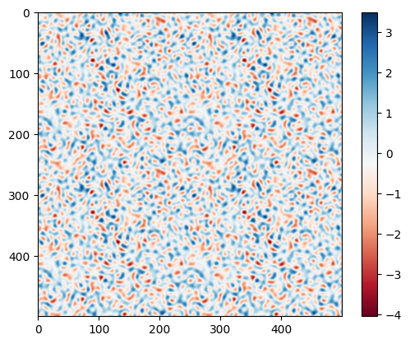
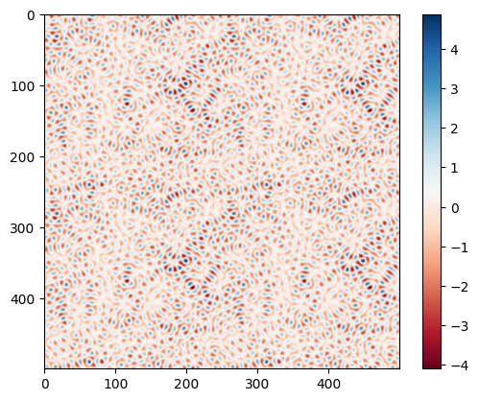
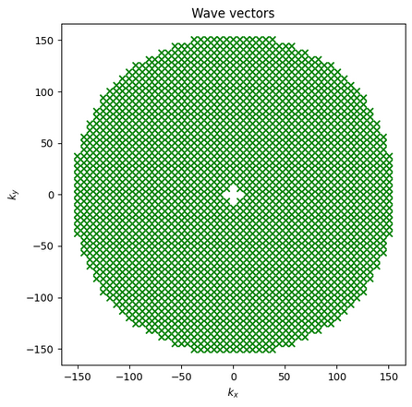
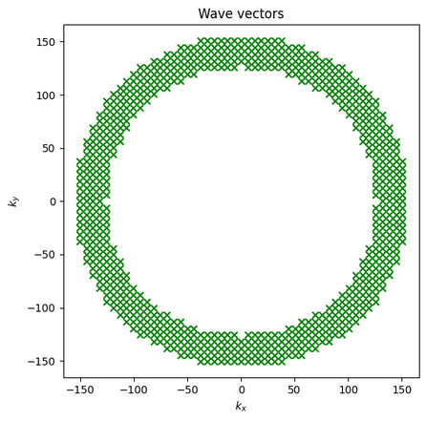
Generating hyperuniform structures
HU scalar fields
Hyperuniformity
Generation of hyperuniform structures and their analysis
MOD-SEM SuSe25 // May 12, 2025
Page 9 of 17

Slide 10
Persistent homology and topological statistics of hyperuniform point clouds [SSDV24]
Hyperuniformity
Generation of hyperuniform structures and their analysis
MOD-SEM SuSe25 // May 12, 2025
Page 10 of 17

Slide 11
Persistent homology [SSDV24]
Persistent Homology and Topological Analysis (Responsible: Bekzat)
A Vietoris–Rips complex is built by growing balls of radius rrr around each point
Homological features are computed: ​h0 (connected components), h1​ (loops)
Task: Use ripser or GUDHI to compute persistent homology and analyze the resulting diagrams
Hyperuniformity
Generation of hyperuniform structures and their analysis
MOD-SEM SuSe25 // May 12, 2025
Page 12 of 17

Slide 12
Persistent homology [SSDV24]
Topological Comparison and Robustness to Finite Sampling (Responsible: AbdulSalam, Nayan)
Wasserstein distances W1W_1W1​, W2W_2W2​ are used to compare persistence diagrams:
1. Across different pattern parameters
2. Between full systems and cropped subsets
The study shows that HU properties are preserved in subsets above a certain size
Task: Compare diagrams using Wasserstein distance, identify HU regions in parameter space, and analyze robustness to partial data
Hyperuniformity
Generation of hyperuniform structures and their analysis
MOD-SEM SuSe25 // May 12, 2025
Page 13 of 17

Slide 13
Literature
[Tor18] Salvatore Torquato. Hyperuniform states of matter. Physics Reports, 745:1–95, 2018. Hyperuniform States of Matter.
[SSDV24] Marco Salvalaglio, Dominic J. Skinner, Jörn Dunkel, and Axel Voigt. Persistent homology and topological statistics of hyperuniform point clouds. Phys. Rev. Res., 6:023107, May 2024.
[MT17] Zheng Ma and Salvatore Torquato. Random scalar fields and hyperuniformity. Journal of Applied Physics, 121(24):244904, 2017.
[SCM24] Aaron Shih, Mathias Casiulis, and Stefano Martiniani. Fast generation of spectrally shaped disorder. Phys. Rev. E, 110:034122, Sep 2024.
Hyperuniformity
Generation of hyperuniform structures and their analysis
MOD-SEM SuSe25 // May 12, 2025
Page 14 of 17

